Slide 1

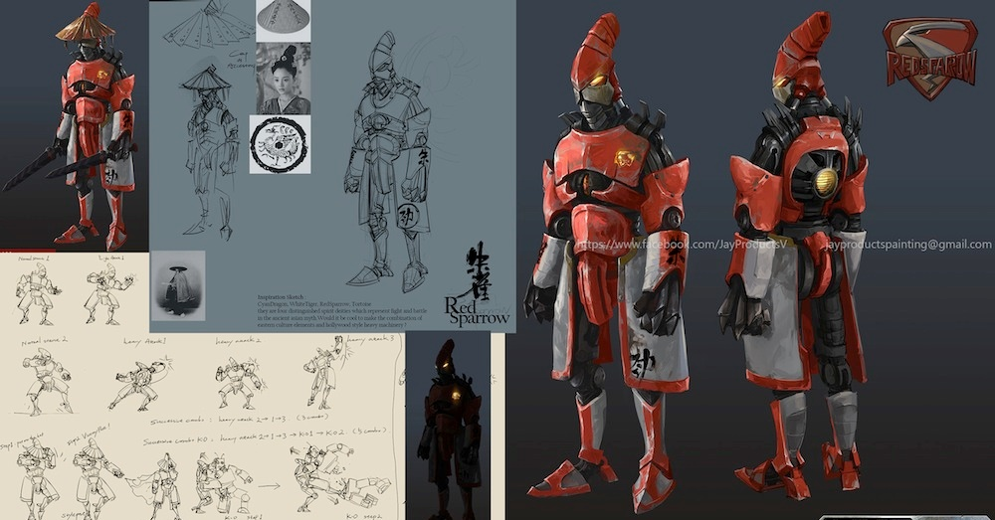
OCR Level 02 – Cambridge Technical
Unit 05 – Creating Business Solutions
2016 Specification - L/615/1436
LO1 - Fundamentals of Game Design

Slide 2
Assessment Criteria
The Learner will | Pass The assessment criteria are the pass requirements for this unit. The learner can: | Merit To achieve a merit the evidence must show that, in addition to the pass criteria, the learner is able to: | Distinction To achieve a distinction the evidence must show that, in addition to the pass and merit criteria, the learner is able to:
1. Know the fundamentals of game design | P1: Describe the fundamentals of game design
2. Be able to generate Game Designs | P2: Outline the game concept | M1: Justify how the concept meets the purpose and features of the game
 | P3: Present the game concept to stakeholders to obtain feedback
 | P4: Produce the design for the game concept based on feedback
3. Be able to create games from game designs | P5: Create the game | M2: Test the functionality of the game | D1: Evaluate the game against the design specification
4. Be able to recommend additional features for game designs | P6: Recommend additional features to improve game design | M3: Consider how the additional features would enhance the original game design | D2: Justify how the game design could be supported on multi-platforms

Slide 3
LO1 – Learning Outcome
Learning Outcome 1: Know the fundamentals of game design
Your task is to: describe the fundamentals of game design.
Pass | Merit | Distinction
P1: Describe the fundamentals of game design
Evidence
An online review, report or video presentation. This must include: different types/genres of games; how a player’s interest is maintained; different types of gaming; the psychological factors of game design.

Slide 4
Assessment Criterion P1
P1 - Learners should research the elements of game design. Learners are required to describe key genres, a range of gaming platforms, how player’s interest is maintained and the psychological aspects considered in game design.
This could be achieved by reviewing different types of games with a different focus, genre or purpose. The evidence for this could be presented as (online) review, report or a video presentation.

Slide 5
LO1 - Assessment Criterion
1.1. Different types (genres) of games, e.g.:
adventure
combat
puzzle
racing
role-play
simulation
sports
Strategy
1.2. Maintaining player’s interest, e.g.:
competitive (e.g. high scores, timing, other players)
control method (e.g. standard controllers, motion sensing)
characters
educational
interaction design (GUI)
progression
skill level required
1.3. Different types of gaming platforms, e.g.:
personal computer
smart phones
tablets
online browser
emulator
1.4. Psychological factors, e.g.:
use of sound
use of virtual reality
peer pressure
addictive
educational value
fun
competitive

Slide 6
Unit 15 – Scenario – Progress Game Hut
Progress Game Hut
Part A
You are a junior game designer at Progress Game Hut. To gain a promotion as a fully endorsed game designer your manager, Harry has asked you to explain to the rest of the game design team the fundamental concepts of game design.
Part B
Design, create, test and evaluate a game.
You have now been allocated a new assignment. Harry wants Progress Game Hut to release a new gaming concept for each blockbuster movie as they are released throughout the year.
Your brief is to choose a film from future movie releases and design a game to promote the movie. You could choose a concept linked to a franchise e.g. ‘007’, ‘Star Wars’, ‘Toy Story’, ‘Despicable Me’ or a completely new blockbuster.
The aim of the game is to promote the new film through entertainment and cliff hangers. Harry aims to release the games at the same time as the blockbuster hits the cinema’s.
He has asked you to think carefully about the target audience.

Slide 7
P1.1 – Game Genres
Almost all games fall under a genre type, (style of game) and some overlap these boundaries. For P1.1 you need to produce a presentation or report to explain the range of genre types to the staff of Progress Game Hut.
The following genres need explaining with examples:
P1.1 – Task 01 - Produce a report or presentation that outlines the ranges of genres of game concepts.
This can be submitted as a formal report or presentation. In your report, explain:
  What their game purpose usually is,
  What similarities are there within the genre,
  A range of examples from different platforms (consoles)
Adventure | Combat | Puzzle | Racing
Role-play | Simulation | Sports | Strategy

Slide 8
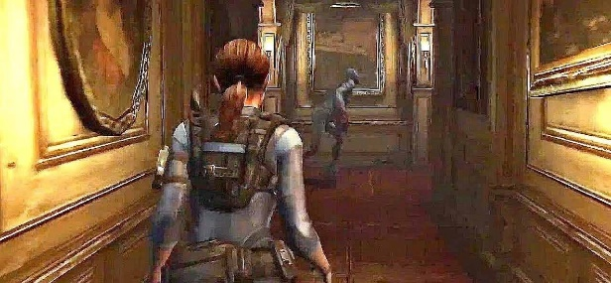
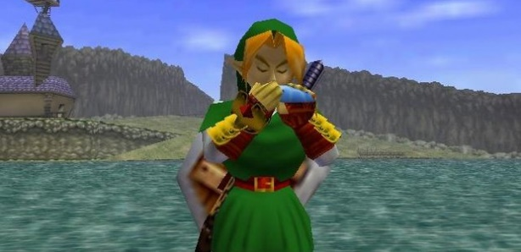

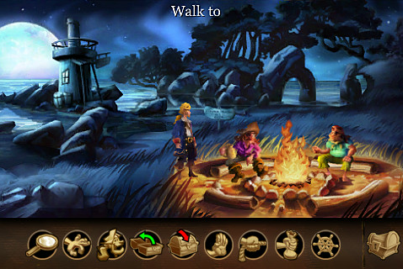
P1.1 – Game Genres - Adventure
A primary feature of an adventure game is the presence of a well-developed story. Many of these games function more like an interactive movie than a traditional RPG. Some of the best examples of adventure games include little, if any, combat.
Instead, players make a series of decisions that directs the course of the story, and the life of the character they are playing. Some of the best recent examples include the Walking Dead series and Life is Strange.
The other kind of adventure is platform, where the character progresses from one side to the other achieving some task or goal to exit the level, either through actions or through simple trap progress.
These can be 2D or 3D.
Click Here

Slide 9
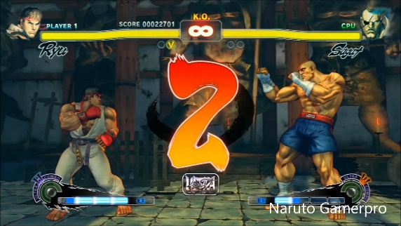
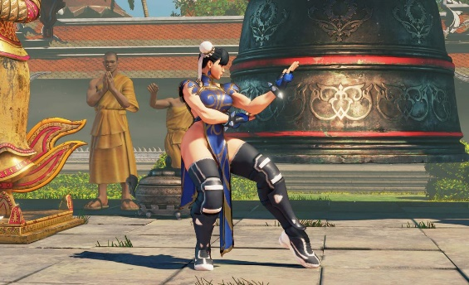
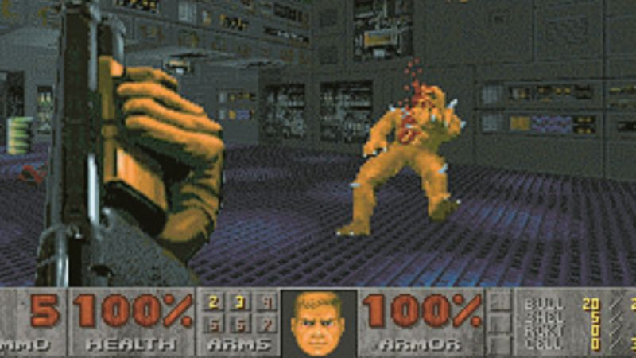
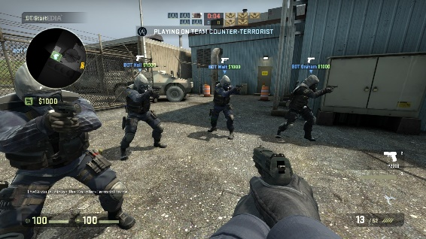
P1.1 – Game Genres - Combat
There are two kinds of combat game, pure fighting and First Person Shooting.
A staple for arcades, the fighting genre pits on players against another, or against an AI-controlled opponent, in rounds of single combat. The goal is simply to exchange blows while attempting to get your opponent’s health bar to zero before yours.
Most featured up to three rounds per battle, with the winner of two out of three being declared the winner. If a player is the winner, they then advance to the next battle in line.
The first person shooter got its name based on the perspective the player is the character. Instead of seeing the entire character within the environment, players are positioned to see how the character would see, including seeing the arms and weapons protruding into the view.
Game play focuses on players working (shooting) their way through a variety of scenarios, following a storyline. Some of the quintessential examples include the Call of Duty, Battlefield, GO and DOOM franchises.
Click Here

Slide 10
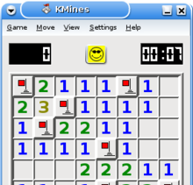
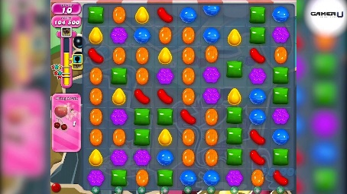
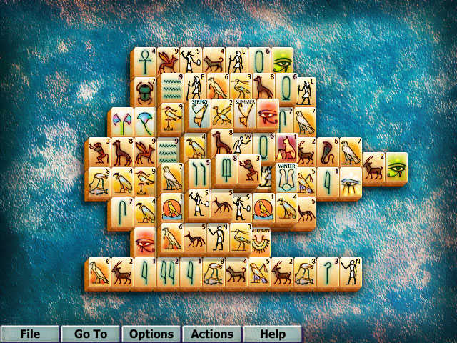
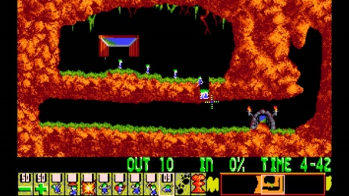
P1.1 – Game Genres - Puzzle
In many ways, puzzle video games are not dissimilar from traditional puzzles. What they offer are unique environments that are not as easily introduced in one's living room.
For example, Wetrix enables the player to build up a series of walls that would be able to contain a deluge of water when it falls. Successful completion of a level involves capturing enough water.
Other examples include Tetris, Intelligent Qube, Puzzle Bobble, Puyo Puyo, Devil Dice, and Candy Crush. These games appeal to those who love to solve difficult puzzles. There are many levels, from beginner to expert, and games usually have coloured shapes and simple actions. These are brain games, with no action
involved.
Click Here

Slide 11

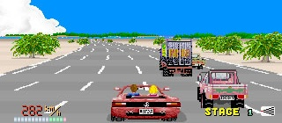
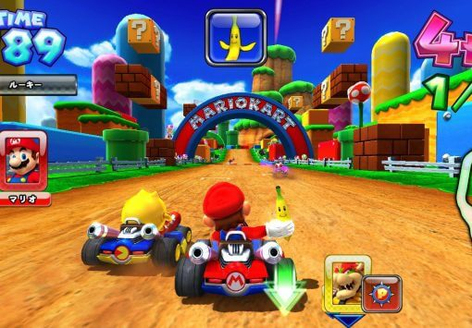

P1.1 – Game Genres - Racing
Racing games come in a variety of formats, but all feature racing at their core. Whether you have access to a garage full of cars that actually exist, like with Gran Turismo, adventure added like Grand Theft Auto or prefer the more cartoonish approach of Mario Kart, the goal is to get around the track faster than your opponents.
Winning races sometimes open’s opportunities to improve the virtual cars and unlock additional tracks, while others are purely for bragging rights.
For some it is the realism that matters rather than the team play or the competition. Games like Gran Turismo sell due to this realism and the chance to drive in realistic environments in classic cars.
Alternative racing can be done on skis, motorbikes, F1, Speed boats and
airplanes.
Click Here

Slide 12
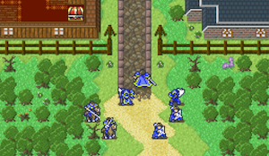
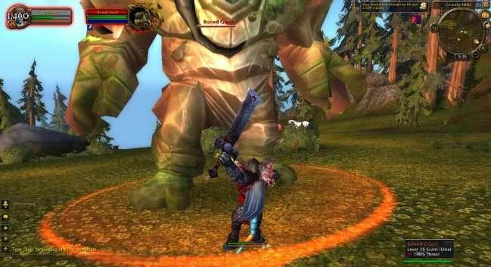
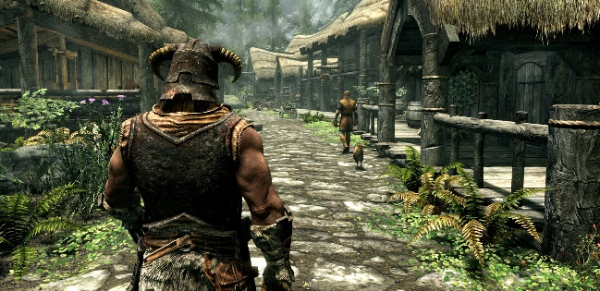
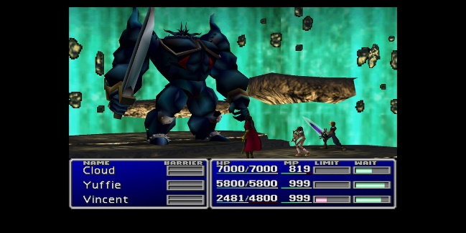
P1.1 – Game Genres – Role Play
The RPG, or Role Playing Game is one of the more story rich options available in gaming today, but often still features a strong combat aspect. Players lead characters through stories, making various choices along the way that impact the story’s conclusion. Free online versions are available, like Stick RPG 2, as well as titles in a traditional console and computer formats, such as the Mass Effect series.
RPGs played online in open worlds full of other players are classified as MMORPGs or Massively Multiplayer Online Role Playing Games. One of the most recognised names in MMORPGs is World of Warcraft (WoW), though the genre was popular before WoW entered the market.
Click Here

Slide 13
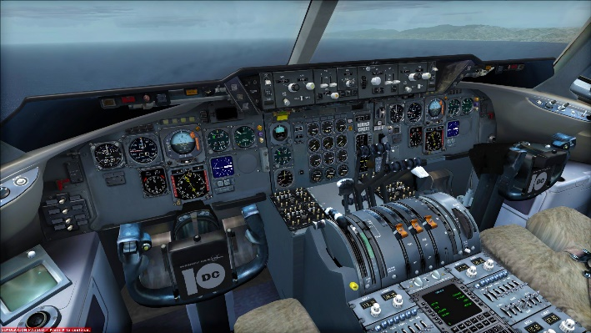
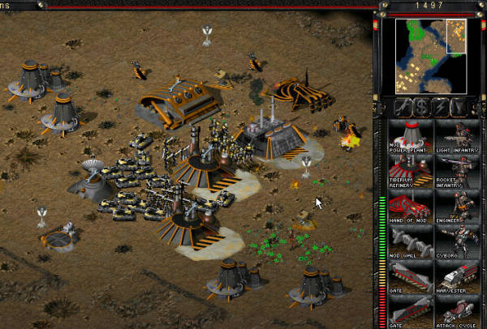
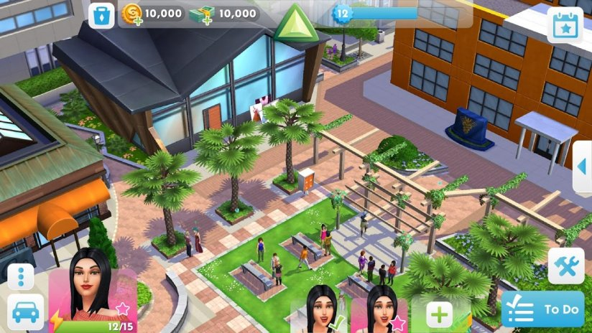
P1.1 – Game Genres - Simulation
By their nature, simulations are attempts to accurately re-create an experience. These can be in the form of management simulations like SimCity and Theme Hospital, or more hands on like Microsoft Flight Simulator or Gran Turismo.
These games involve taking control of real-world vehicles, including tanks, ships, and aircraft. You learn how to control these vehicles, and use simulation games that can also be used to train professionals. In fact, many pilots are trained using airplane simulators before they actually take flight.
What keeps the user coming back is the realism of the levels. People even fly a full real time flight in flight simulators, even the boring bits.
Click Here

Slide 14
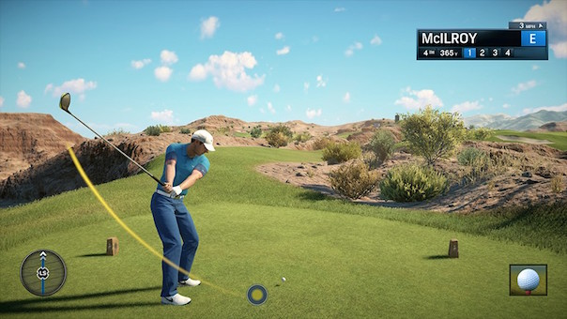
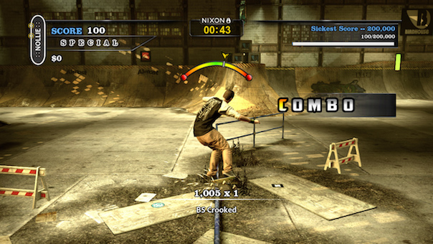
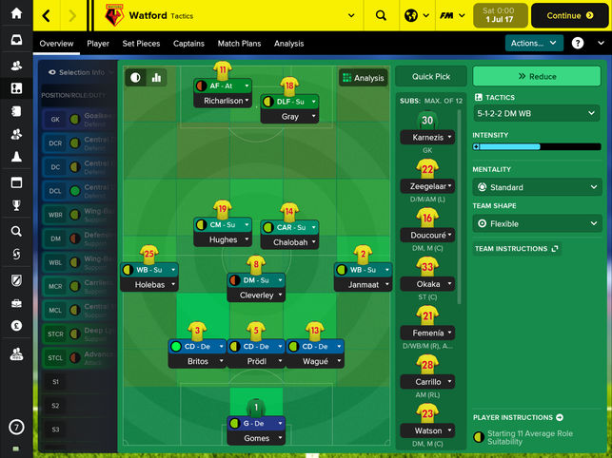
P1.1 – Game Genres - Sports
Similar to racing in regards of the simplicity of the premise, sports games have players simulate the experience of playing a particular sport.
Most professional sports, such as football and basketball, are represented, as well as combat sports, like UFC and extreme sports, like trick skateboarding. Players either work to win games or score points, depending on the exact sport involved.
There are very few sports that have not been turned into a game of some sort.
What keeps the user coming back is the realism and the familiarity as well as the ability to team or rival play. With more modern sports game it is about progressing through the leagues or completing a full season.
Click Here

Slide 15

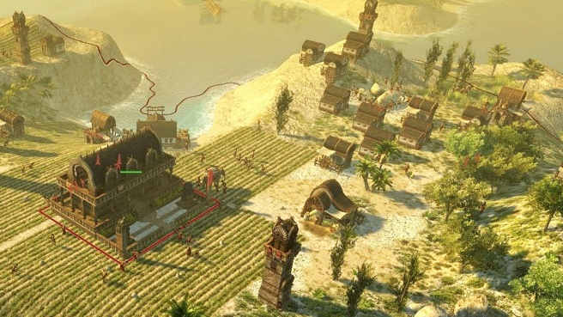
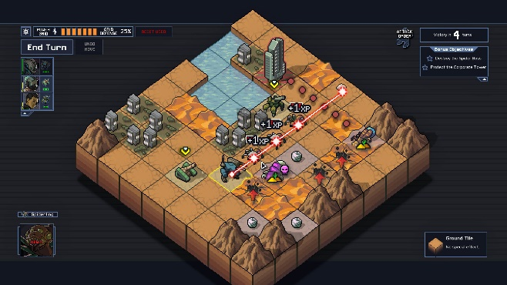
P1.1 – Game Genres - Strategy
Strategy games and Real-time strategy allows players to control large armies, developing their weapons and bases, and working towards a specific mission. It is the video game equivalent to chess, with each side making a series of moves to try and outdo the other.
One of the games that originally popularised the genre on a large scale was the Command and Conquer series, while Dawn of War and Age of Empires are more recognised examples today.
Click Here

Slide 16
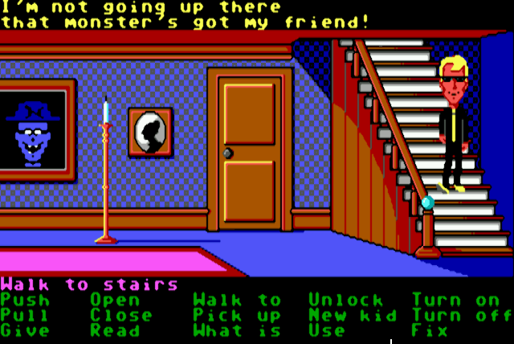
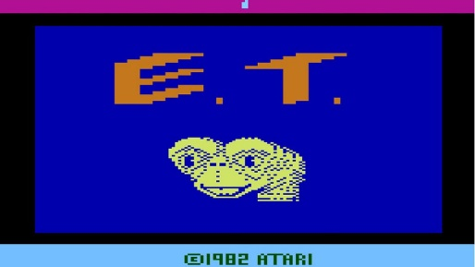
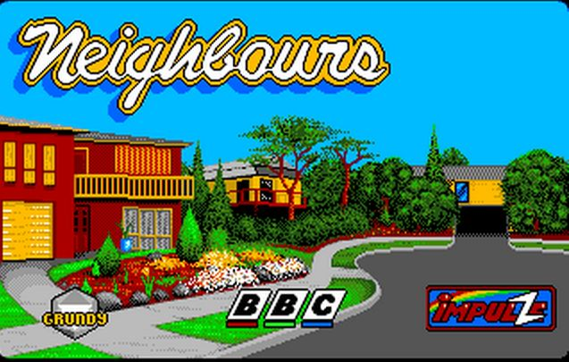
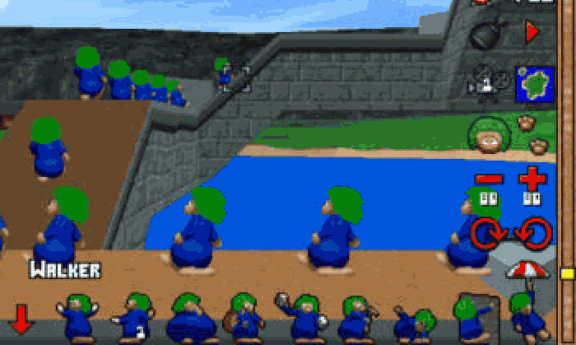
P1.2 – Maintaining Players Interest
With such a variety of genres, game players tend to settle on one or two and play a game within that genre to death. But what keeps them coming back to the same game comes down to personal preferences.
Maintaining interest is a difficult thing to program into a game, it comes down to multiple factors, all of which can make or break a game.
P1.2 – Task 02 - Produce a report or presentation that outlines the different player needs used in games to maintain players interests.
This can be submitted as a formal report or presentation. In your report, explain:
  competitive (e.g. high scores, timing, other players)
  control method (e.g. standard controllers, motion sensing)
  characters
  educational
  interaction design (GUI)
  progression
  skill level required

Slide 17
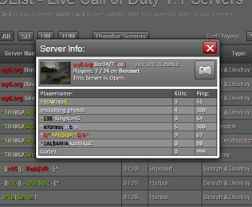
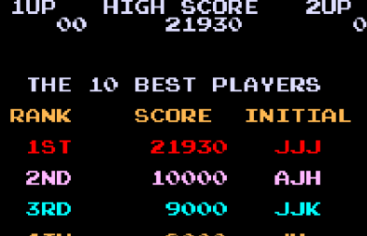
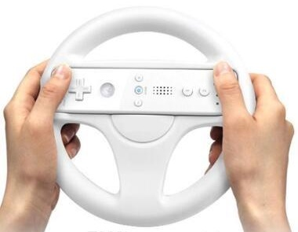
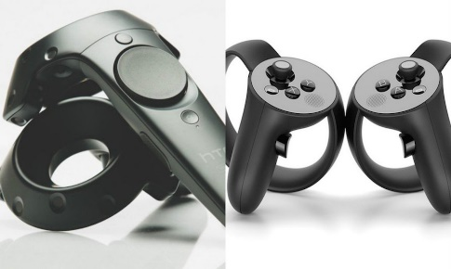
P1.2 – Maintaining Players Interest
  Competitive (e.g. high scores, timing, other players) – some players enjoy games simply to score more than others, get on the high score table, more headshots, clocking up the bodies, going faster than the previous times. The increase of online content, and online play has meant that almost all games need some online content to make them more competitive. The popularity of WOW against the adrenaline rush of COD is a good example of how competition drives players to come back.
  Control method (e.g. standard controllers, motion sensing) – If you look at the history of joypads and controllers and see that we have settled on one style now because we all like to play one way, our way, but more modern inventions such as touch screens, motion sensing like Xbox and Wii controllers, and the new VR, companies are always looking for new methods without compromising the older more able systems to keep gamers active.
  Look at how the Wii controllers have helped sell Wii games, and then think about how slow sales of VR games are with the lack of controller responsiveness.

Slide 18
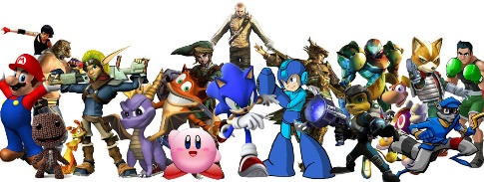
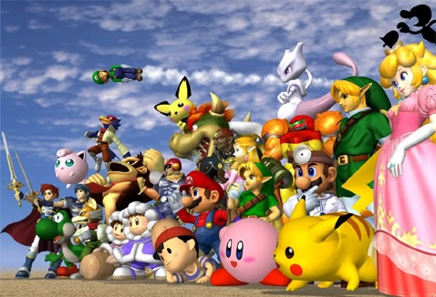
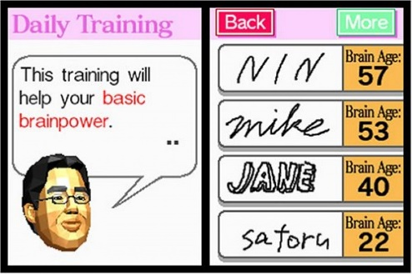
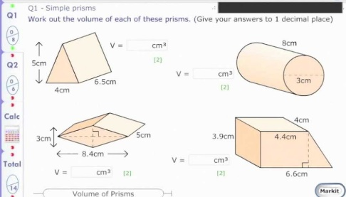
P1.2 – Maintaining Players Interest
  Characters – There was a time when games were merely white lines and square dots to hit, but then we had Mario, Sonic, Larry, Lara, Master Chief. To add to the quality and action we have character development, history, back stories, development, even the enemies have characters.
  To enhance a game and build a franchise you needs characters. For the scenario you will be given the character already, building a game and developing the character will require little more than programming. With new AI you can also influence how your character develops. (see Fable)
  Educational – For some progress is not just merely levelling up or getting bigger weapons, some games are designed to be educational with levels of advancement and difficulty to push that educational level up.
  With games like Doctor Kawashima brain training, these set the trend in progressing through learning. But we also have puzzle games, quiz games, MyiMaths. Most educational sites have games that progress the students through learning and trial, remembering their levels and pushing the boundaries with each try.

Slide 19
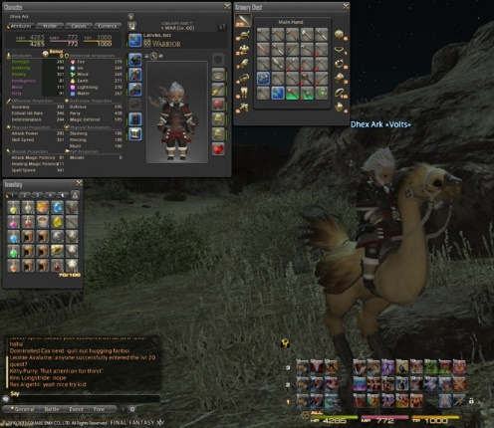
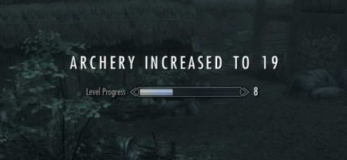
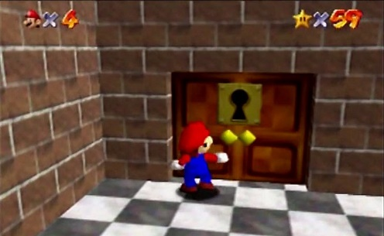
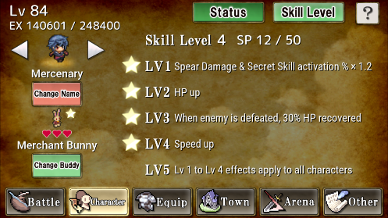
P1.2 – Maintaining Players Interest
  Interaction design (GUI) – Then menu is important, it has to be easy t navigate and use as well as fully functional. The in-menu system is just as important. One of the first things said about a Final Fantasy review is the UI, is it easy, how does the characters move, how do they fight, how does the selection process work. Get it wrong and the users are put off playing.
  Progression – Levelling up, it is a boast as well as a perk, being able to access and wear better equipment, being able to fight better, enter new areas play levels out of reach. Or moving up a league or division for spots games, moving to new areas and new missions in RPG’s, or the need to play on to you get to the end. WOW has only been completed by one person, new levels keep the user interested and the downloading need to continue.
  Skill level required – Linked to levelling up, the building up of skills and the adding new skills to the character adds to the need to play on. A lot of RPG;s use this as the incentive to play on beyond the game, upping stats and buying new kit.

Slide 20
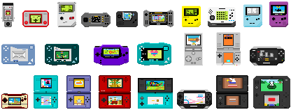
P1.3 – Gaming Platforms
Back in the days, jumpers for goalposts, games came on a console and a handheld, one game each cartridge and a handheld with one game only. Now that variety of media has changed but the concept is still the same.
For P1.3, you need to describe the different platforms that are available and outline some of the differences in gaming abilities and limitations these platforms bring to gaming.
P1.3 – Task 03 - Produce a report or presentation that outlines the different gaming platforms and limitations of these used in games.
You will need to cover the following gaming platforms.
  Personal computer
  Smart phones
  Tablets
  Consoles
  Online browser
  Emulator
Click Here

Slide 21
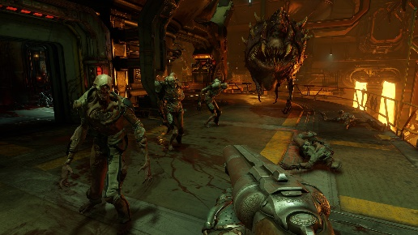

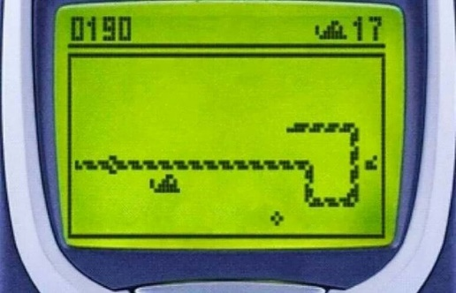
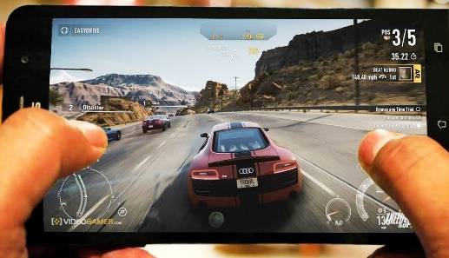
P1.3 – Gaming Platforms
  Personal computer – PC and Mac games are the second most popular gaming format on the market and have been steady for 30 years. They are not designed primarily as gaming machines but games on these devices have developed over deceased to make them equal in quality to newer consoles. The benefit of PC’s is the upgrade factor, game not good enough, add a card.
  The additional benefit is the control methods, keyboards with 102 keys, programmable, mouse controlled character and a range of joypads, sticks and monitor resolutions makes them hugely beneficial gaming devices.
  Smart phones – This is a modern trend for games to be limited to a small device but through the years the quality has improved with software technologies pushing gaming quality. First there was snake, now the popularity of games like Candy Crush show that the market is huge, bigger than gaming consoles.
  Limitations include storage, memory capacity, battery life, small screen, dual processing, touch screens,
  and CPU power.
Click Here

Slide 22
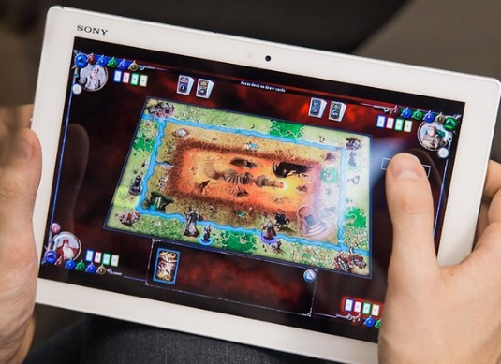
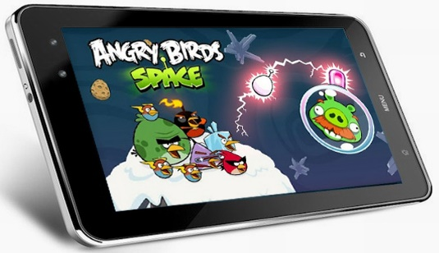
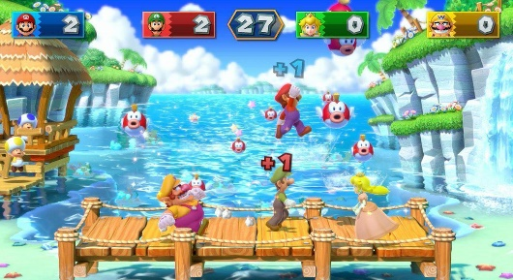

P1.3 – Gaming Platforms
  Tablets – Similar to phones, these are a new generation of game playing devices that are quickly working their way towards being called handheld. The larger screens makes then superior to phones as well as faster CPU’s but they are still limited in memory capacity and graphics handling. Games are not as complex due to control restrictions so they use more pop out menus and selection systems. Touch screen games that require capacitive swiping particularly are easy to control.
  Consoles – In the gaming world there has always been consoles and with each four year generation there has been updated versions, usually rival versions to push the market forward. High selling PC and handheld games usually end up with a console release due to the broader and more specific device gaming market.
  Games that are more difficult to create on a console include RTS and RPG, but the ability as the best hardware devices and the storage and memory capacity has made them the key gaming reference.
Click Here

Slide 23
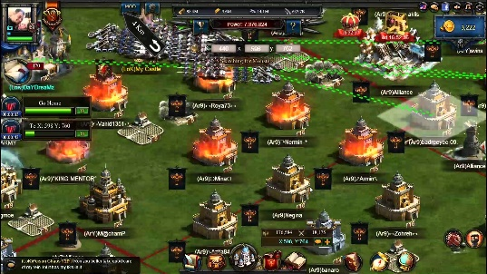



P1.3 – Gaming Platforms
  Online browser – Browser games are difficult to manage in that every computer capacity and setup is different so the games have to aim at a low end PC market to play. Games tend to require additional software emulation installation like Flash or Shockwave in order to universally manage the device drivers.
  Limitations to these include drivers, compatibility, ability to save and come back. Therefor the games themselves tend to be lower quality, simpler games that require little instruction. Examples include
  Emulator – Games from consoles long past can be run within emulators using specific software control. Keys have to be configured and then the game loaded. With good emulators such as Project64, the quality of the game will be as exact as the original with options to save, load and screenshot.
  The advantage is the back catalogue of games, portability, the disadvantage is compatibility, configuring controls, legal issues with roms and speed. Newer consoles can also be emulated but the need for better hardware to emulate is there.
  Similar emulation is available on consoles such as the Lakka and EasyBox.
Click Here

Slide 24

P1.4 – Psychological Factors
Other factors built into games make the experience more personal or enjoyable, and add to the experience or need to addictive nature of games.
For P1.4, you need to explain to staff how these factors have to be considered or can be harnessed in order to improve game sales.
P1.4 – Task 04 - Produce a report or presentation that outlines the different psychological factors that influence gaming.
You will need to cover the following psychological factors:
  use of sound
  use of virtual reality
  peer pressure
  addictive
  educational value
  fun
  competitive
Click Here

Slide 25




P1.4 – Psychological Factors
Use of sound – A game without sound can be tolerated, a console game without sound cannot. The noises of FIFA, the creaking in Resident Evil, the voices in Mario, the revving in Gran Turismo, the pops in Bubble Pop. All these go into making the game more fun and realistic. Programming it takes the least of storage space but adds a lot to the content. Become iconic on top of that and your game will have something else that adds to the USP.
Use of virtual reality – New technologies are not yet tried and tested but they get there in the end, VR is one of these things, the new experience helps add to the game, something that has not been done before and adds to the physical and emotional enjoyment of game playing.
This immersive feel makes it different, we all know that the technology is flawed and we
know that one day it will be the standard.
Quiz
Click Here

Slide 26




P1.4 – Psychological Factors
Peer pressure – All your friends are playing it so you should. Think about how many of your friends have the same game as you, play in competition as you, talk about their achievements within a game. The peer pressure and sales pressure of upgrading to the newest version of the game, to get the newest downloads, to have what everyone else is playing is hard to program but easy to market in the gaming world.
Addictive – The health risks aside, gaming is addictive, the rush of adrenaline, the elation of finishing a level or killing a guardian. Look at the way people shout at their games, or act online when playing. Programming this in usually means adding rewards for play, prizes, adding content, fuelling the addiction.
Educational value – For parents the idea of you playing games all day is horrifying but if they are educational, if they have some degree of content that makes you better then this can justify the allowance. Others play games simply because they are educational, good for the brain cells, Sudoku, scrabble, chess.
Click Here

Slide 27




P1.4 – Psychological Factors
Fun – The biggest reason we play game sis because they are fun and the fun elements that go into programming a game add to this feeling. This is the reason why so many games are still cartoon like, they appeal to our inner child. The popularity of Mario and Sonic was all about the fun element, even with the repetitive nature if the games. They are a distraction from reality, something we do that does not matter, an achievement in life that is personal.
Competitive - We all know someone who is level 99 dragon lord or has competed GTA, finished the seasons on FIFA, ranked number one in Gran Turismo, completed Mario and Zelda, got all the Dragon Armour in Skyrim, flapped over 1000 columns in Flappy Birds.
The competitive nature of games is a big driving force, it allows us to boast of our ability, to show how good we are. In games there are no participation medals, it is all about the drive to achieve, to get better, to add one more point. Otherwise why have a high score table.
Find any game that does not progress or any modern console game that does not show your stats online for others to see.
Click Here

Slide 28
LO1 – Assessment Criteria
P1.1 – Task 01 - Produce a report or presentation that outlines the ranges of genres of game concepts.
P1.2 – Task 02 - Produce a report or presentation that outlines the different player needs used in games to maintain players interests.
P1.3 – Task 03 - Produce a report or presentation that outlines the different gaming platforms and limitations of these used in games.
P1.4 – Task 04 - Produce a report or presentation that outlines the different psychological factors that influence gaming.

